Slide 1
CS4038
DATA MINING
LECTURE # 24
SPRING 2024
FAST – NUCES, CFD CAMPUS
AYESHA LIAQAT
ayesha.liaqat@nu.edu.pk

Slide 2
TODAY’S TOPICS
Hierarchical Clustering (continued)

Slide 3
HIERARCHICAL CLUSTERING

Slide 4
HOW TO DEFINE INTER-CLUSTER DISTANCE
 | p1 | p2 | p3 | p4 | p5 | .
p1
p2
p3
p4
p5
.
. .
Similarity?
MIN
MAX
Group Average
Distance Between Centroids
Other methods driven by an objective function
– Ward’s Method uses squared error
.
.
Proximity Matrix

Slide 5
HOW TO DEFINE INTER-CLUSTER DISTANCE
 | p1 | p2 | p3 | p4 | p5 | .
p1
p2
p3
p4
p5
.
. .
●
MAX
Group Average
Distance Between Centroids
Other methods driven by an objective function
– Ward’s Method uses squared error
MIN
.
.
Proximity Matrix
5

Slide 6
HOW TO DEFINE INTER-CLUSTER DISTANCE
 | p1 | p2 | p3 | p4 | p5 | .
p1
p2
p3
p4
p5
.
. .
MIN
●
Group Average
Distance Between Centroids
Other methods driven by an objective function
– Ward’s Method uses squared error
MAX
.
.
Proximity Matrix
6

Slide 7
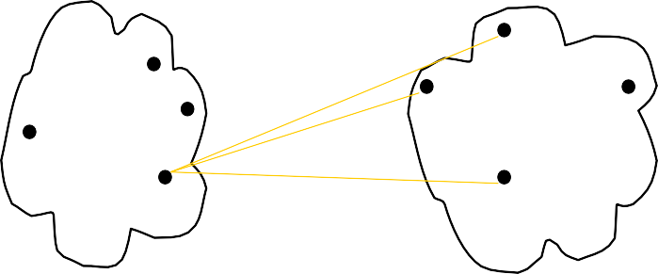
HOW TO DEFINE INTER-CLUSTER DISTANCE
 | p1 | p2 | p3 | p4 | p5 | .
p1
p2
p3
p4
p5
.
. .
MIN
MAX
●
Distance Between Centroids
Other methods driven by an objective function
– Ward’s Method uses squared error
Group Average
.
.
Proximity Matrix
7

Slide 8
HOW TO DEFINE INTER-CLUSTER DISTANCE
 | p1 | p2 | p3 | p4 | p5 | .
p1
p2
p3
p4
p5
.
. .
×
×
MIN
MAX
Group Average
●
Other methods driven by an objective function
– Ward’s Method uses squared error
Distance Between Centroids
.
.
Proximity Matrix

Slide 9
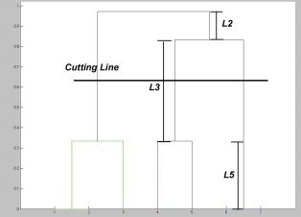
HIERARCHICAL CLUSTERING
Dendogram cut-off

Slide 10
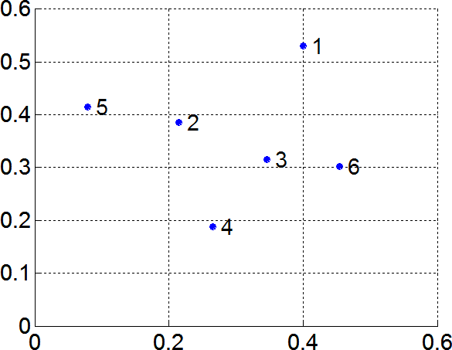
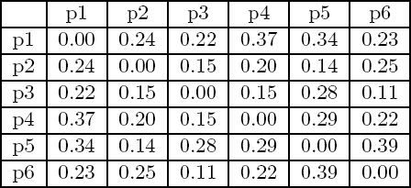
MIN OR SINGLE LINK
Proximity of two clusters is based on the two closest points in the different clusters
Determined by one pair of points, i.e., by one link in the proximity graph
Example:
Distance Matrix:

Slide 11
HIERARCHICAL CLUSTERING: MIN
5
1
3
5
2
1
0.2
2
3
6
0.15
0.1
4
4
Nested Clusters
0.05
0
3
6 2
Dendrogram
5
4
1

Slide 12
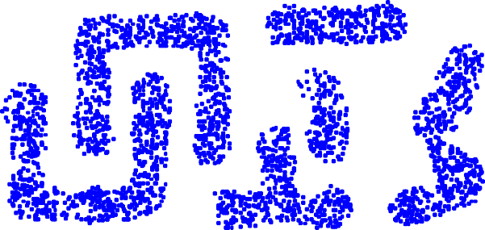
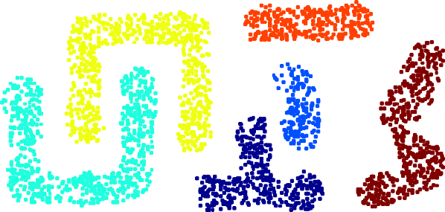
STRENGTH OF MIN
Original Points
Six Clusters
Can handle non-elliptical shapes

Slide 13
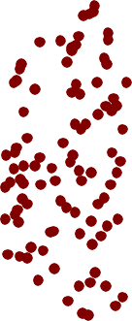
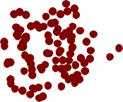
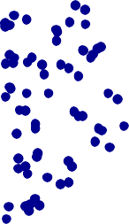
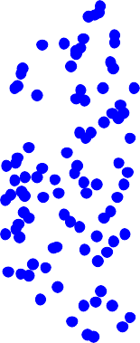
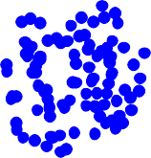
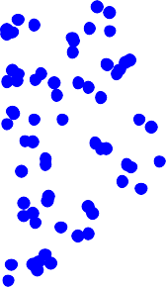
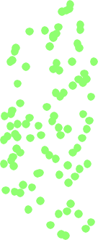
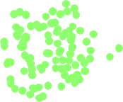
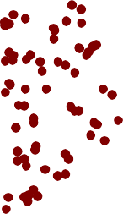
LIMITATIONS OF MIN
Two Clusters
Original Points
Sensitive to noise and outliers
Three Clusters

Slide 14
MAX OR COMPLETE LINKAGE OR CLIQUE
Proximity of two clusters is based on the two most distant points in the different clusters
Determined by all pairs of points in the two clusters
Distance Matrix:

Slide 15
HIERARCHICAL CLUSTERING: MAX
4
1
2
5
5
0.4
2
0.35
0.3
3
6
0.25
3
0.2
1
0.15
4
0.1
0.05
0
3
6 4
Dendrogram
1
2
5
Nested Clusters

Slide 16

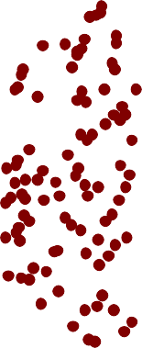


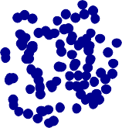

STRENGTH OF MAX
Original Points
Two Clusters
Less susceptible to noise and outliers
MAX approach does well in separating clusters if
there is noise between clusters.

Slide 17
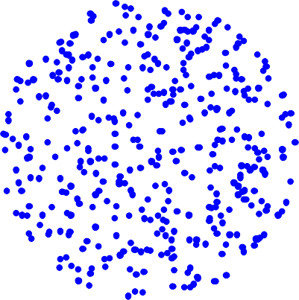
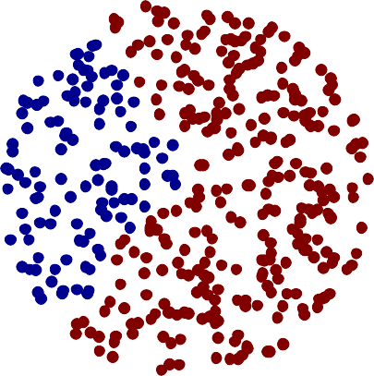
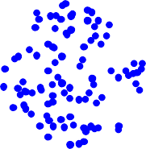
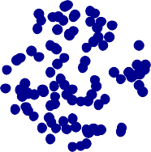
LIMITATIONS OF MAX
Original Points
Two Clusters
•
Tends to break large clusters
Biased towards globular clusters

Slide 18
GROUP AVERAGE
Proximity of two clusters is the average of pairwise proximity between all pairs of points in the two clusters.
∑proximity(p_{i} ,p_{j} )
p_{i}∈Cluster_{i}
proximity(Cluster_{i} , Cluster_{j} ) =
p ∈Cluster
j j
|Cluster_{i} |×|Cluster_{j} |
Distance Matrix:

Slide 19
HIERARCHICAL CLUSTERING: GROUP AVERAGE
5
4
1
2
0.25
5
2
0.2
3
0.15
6
0.1
1
0.05
4
3
0
3
6
4
1
2
5
Nested Clusters
Dendrogram

Slide 20
HIERARCHICAL CLUSTERING: GROUP AVERAGE
Compromise between Single and Complete Link
Strengths
Less susceptible to noise
Limitations
Biased towards globular clusters

Slide 21
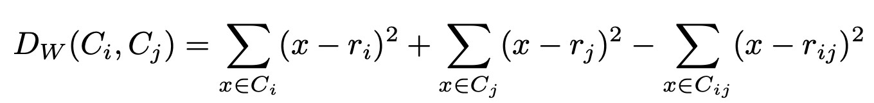
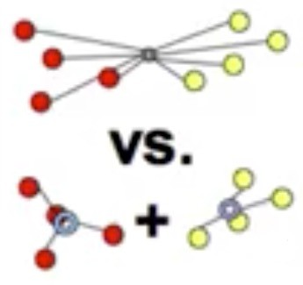
CLUSTER SIMILARITY:WARD’S METHOD
Similarity of two clusters is based on the increase in squared error when two clusters are merged
Similar to group average if distance between points is distance squared
Ward’s distance between clusters C_{i} and C_{j} is the difference between the total within cluster sum of squares for the two clusters separately, and the within cluster sum of squares resulting from merging the two clusters in cluster C_{ij}
r_{i}: centroid of C_{i} r_{j}: centroid of C_{j} r_{ij}: centroid of C_{ij}

Slide 22
CLUSTER SIMILARITY:WARD’S METHOD
Similarity of two clusters is based on the increase in squared error when two clusters are merged
Similar to group average if distance between points is distance squared
Less susceptible to noise
Biased towards globular clusters
Hierarchical analogue of K-means
Can be used to initialize K-means

Slide 23
HIERARCHICAL CLUSTERING: COMPARISON
₁5
4
3
1
5
2
5
2
1
5
2
MIN
2
3
MAX
6
3
6
3
1
4
4
4
₁ 5
5
4
1
2
2
Group
5
2
5
2
Average
3
6
Ward’s Method
3
6
3
1
1
4
4
4
3

Slide 24
STRENGTHS OF HIERARCHICAL CLUSTERING
Do not have to assume any particular number of clusters
Any desired number of clusters can be obtained by ‘cutting’ the dendrogram at the proper level
They may correspond to meaningful taxonomies
Example in biological sciences (e.g., animal kingdom, phylogeny reconstruction, …)

Slide 25
HIERARCHICAL CLUSTERING: TIME AND SPACE REQUIREMENTS
O(N²) space since it uses the proximity matrix.
N is the number of points.
O(N³) time in many cases
There are N steps and at each step the size, N², proximity matrix must be updated and searched

Slide 26
HIERARCHICAL CLUSTERING: PROBLEMS AND LIMITATIONS
Once a decision is made to combine two clusters, it cannot be undone
No global objective function is directly minimized
Different schemes have problems with one or more of the following:
Sensitivity to noise
Difficulty handling clusters of different sizes and non-globular shapes
Breaking large clusters

Slide 27
READING MATERIAL
Chapter 8:Tan, Steinbach & Kumar
Chapter 10: Han, Kamber & Pei
Articles on Hierarchical clustering:
https://www.kdnuggets.com/2019/09/hierarchical-clustering.html
https://towardsdatascience.com/machine-learning-algorithms-part-12-hierarchical- agglomerative-clustering-example-in-python-1e18e0075019

